Slide 1

ShopSmart – Serverless E‑Commerce Application A Professional Cloud-Native Solution Built on AWS
Presented By:
Hawi Jordan: Senior Developer
Amarachi Emeziem: Product Architect
Rory Mclean: Quality Assurance
MD Shohel Khan (Sohel): Senior Developer
Olusegun Ajayi-Johnson: Project Manager
AWS Cloud Engineers
Notes:
Hawi Slide 1 – 4

Slide 2
What is ShopSmart?
A simple e‑commerce system built using AWS serverless services.
Users can browse products, add items to the cart, and simulate checkout.
Frontend hosted on Amazon S3; backend powered by AWS Lambda (Python).
Designed to be scalable, secure, and cost-efficient.
Demonstrate real-world industry skills.

Slide 3
Why Serverless?
No Server management required
Automatically scales with customer traffic
Pay-per-use cost model
High availability and reliability
Follows modern cloud engineering standards.

Slide 4
AWS Services Used
AWS CloudShell
Amazon S3
Amazon API Gateway
AWS Lambda
Amazon DynamoDB
AWS IAM (Identity & Access
Management)
Amazon Cognito
Notes:
Olu 4 -5

Slide 5
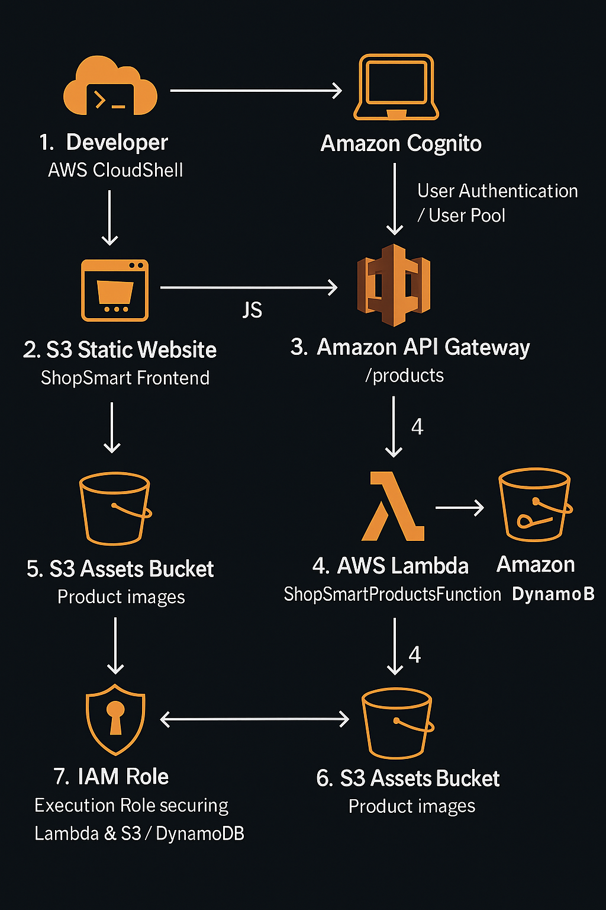
Architecture Overview

Slide 6
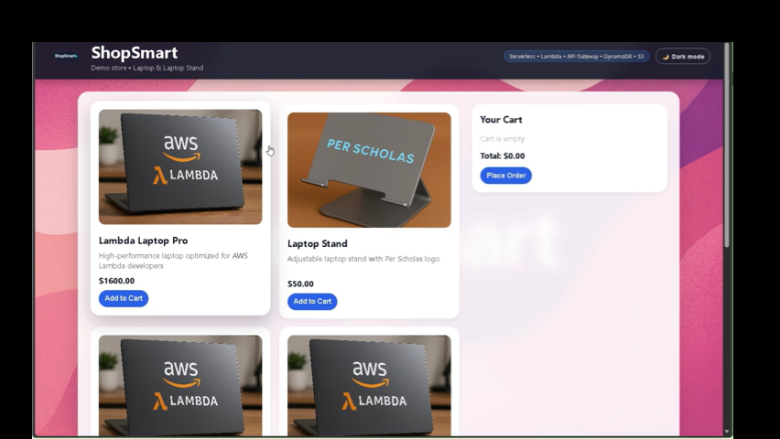
Live Demo
http://shopsmart-hkilla-2025.s3-website-us-east-1.amazonaws.com/
Notes:
Rory

Slide 7
Challenges We Faced
API Gateway Integration Issues
Problem:
When connecting API Gateway to Lambda, the frontend wasn’t receiving the correct product data.
Requests failed or returned formatting issues.
Solution:
Configured the correct Lambda integration in API Gateway
Adjusted method response and integration response settings
Ensured Lambda returned proper JSON data
Updated IAM permissions so API Gateway could invoke Lambda
Tested with CloudShell using curl to confirm responses
Result:
API Gateway successfully triggered Lambda, and the frontend received clean JSON data.

Slide 8
Challenges We Faced
S3 Static Website & Permissions
Problem:
The website hosted on S3 wasn’t loading correctly.
The browser showed “Access Denied” or missing images.
Solution:
Added a public-read bucket policy for static hosting
Enabled Static Website Hosting in the S3 bucket
Uploaded correct index.html and asset folder structure
Set proper MIME types so images and scripts load correctly
Verified accessibility using the S3 website endpoint URL
Result:
The website loaded successfully, and product images displayed with no issues.

Slide 9
WHAT WE ACHIEVED
Successfully deployed a working, fully serverless application.
Gained hands‑on experience with real AWS cloud architecture.
Created a production‑style capstone project suitable for GitHub and interviews.
Demonstrated end‑to‑end cloud engineering and documentation skills.
Notes:
Shohel

Slide 10
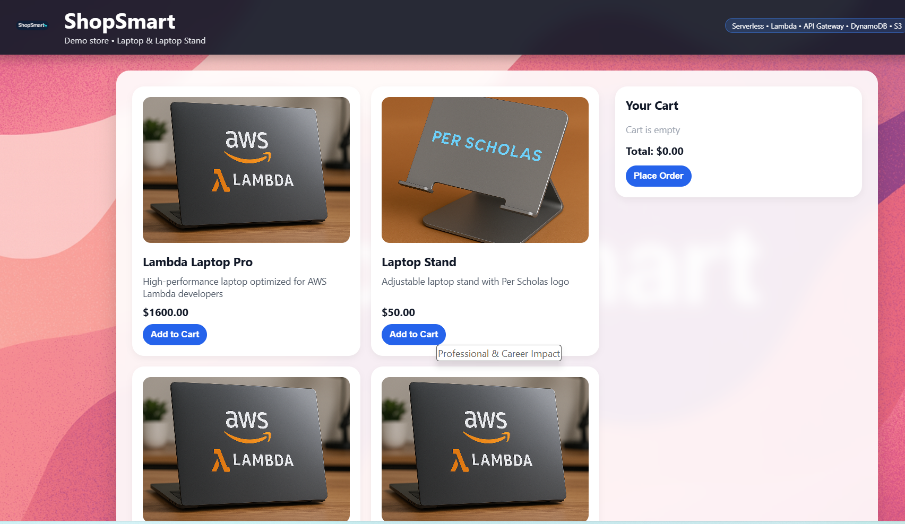
Website Screenshot
Notes:
Shohel

Slide 11
Appreciations
Thanks to our instructors (Nosa Okundaye and Jose Santos) for guiding us on this great project.
THANK YOU FOR YOUR TIME

